Slide 1
Machine Learning with Spark
Gokul Krishna K V
HSDP - BDP
19-07-2019

Slide 2
Agenda
History of Machine Learning and types
Spark Introduction
What is Spark Mlib?
ML Process Overview
Spark Mlib Components
Spark Mlib pipeline
Example
Spark Model export/import

Slide 3
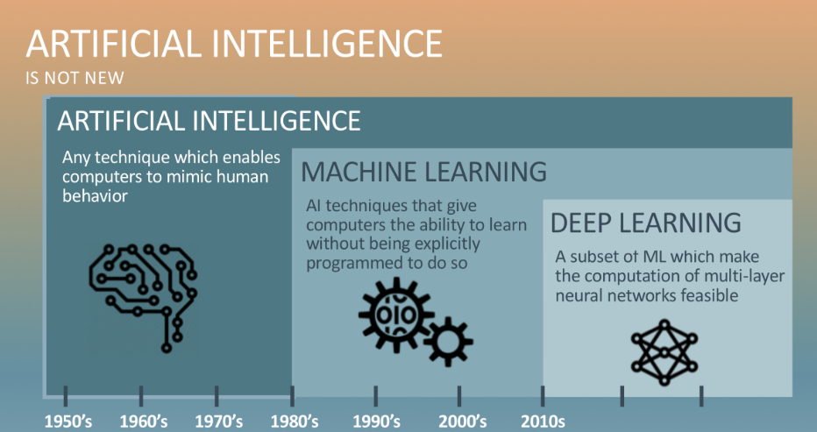
ML , DL , AI HISTORY

Slide 4
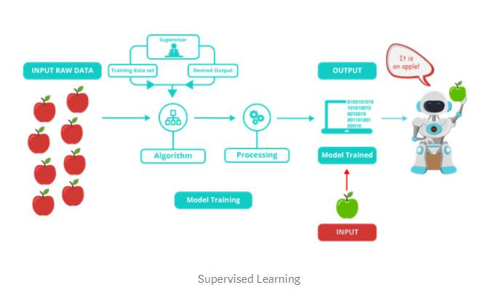
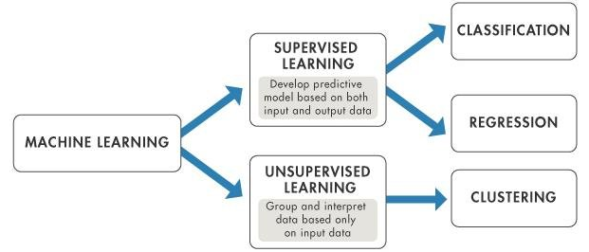
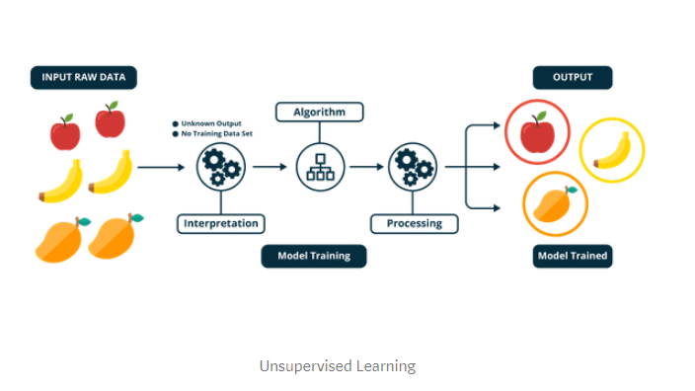

Machine Learning TYPES

Slide 5
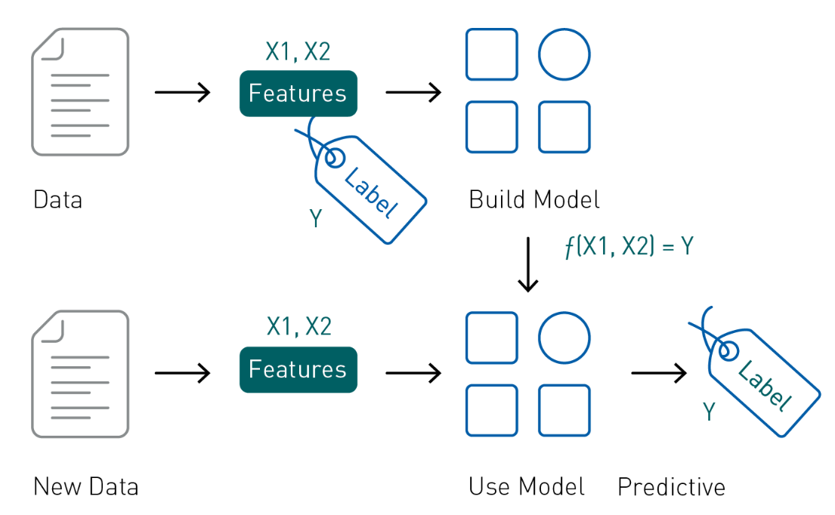
Supervised Machine Learning

Slide 6
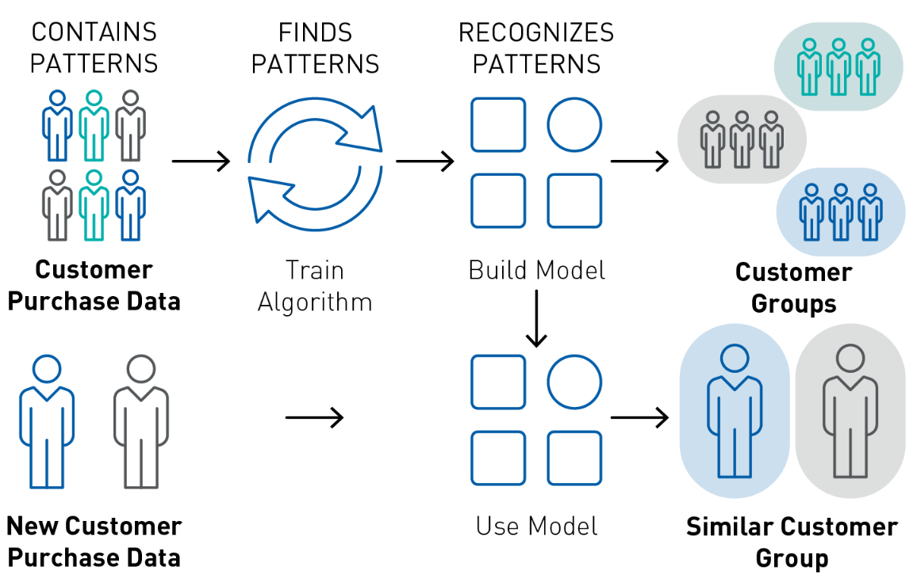
Un-Supervised Machine Learning Overview
Unsupervised learning, also sometimes called descriptive analytics, does not have labeled data provided in advance. These algorithms discover similarities, or regularities, in the input data. An example of unsupervised learning is grouping similar customers, based on purchase data

Slide 7
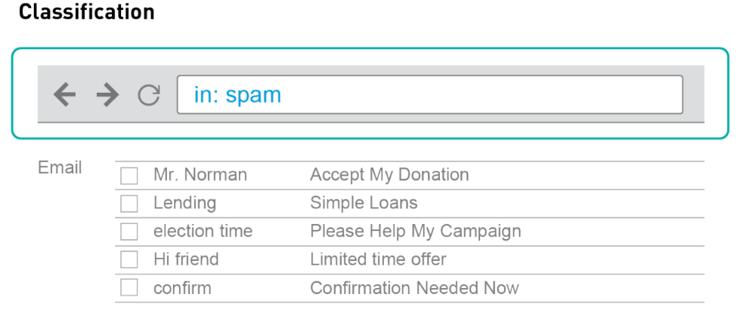
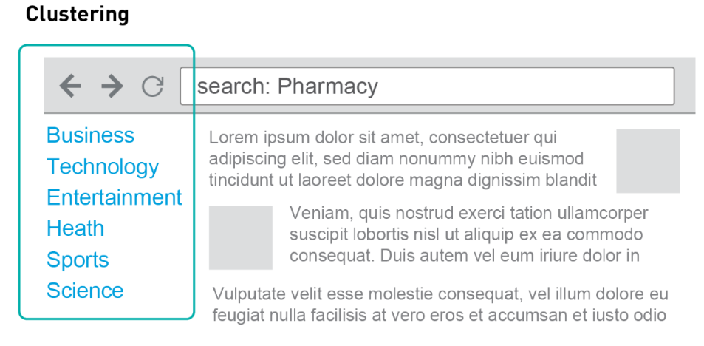
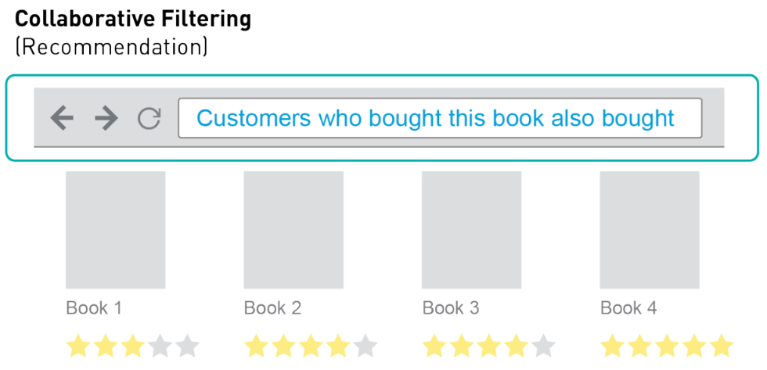
Examples – Supervised/Un-supervised Machine Learning
Classification : Gmail uses a machine learning technique called classification to designate if an email is spam or not, based on the data of an email: the sender, recipients, subject, and message body. Classification takes a set of data with known labels and learns how to label new records based on that information
Clustering: Google News uses a technique called clustering to group news articles into different categories, based on title and content. Clustering algorithms discover groupings that occur in collections of data
Collaborative Filtering: Amazon uses a machine learning technique called collaborative filtering (commonly referred to as recommendation) to determine which products users will like, based on their history and similarity to other users

Slide 8
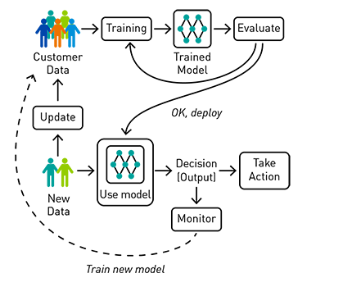
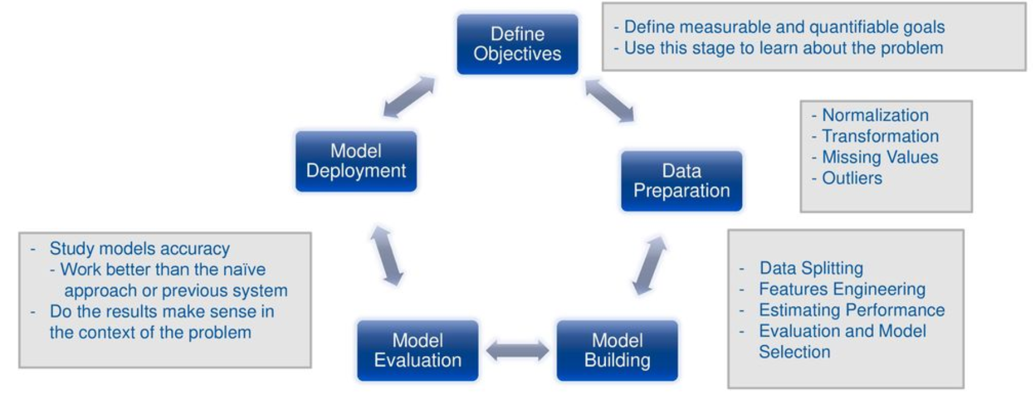
ML Process - Overview

Slide 9
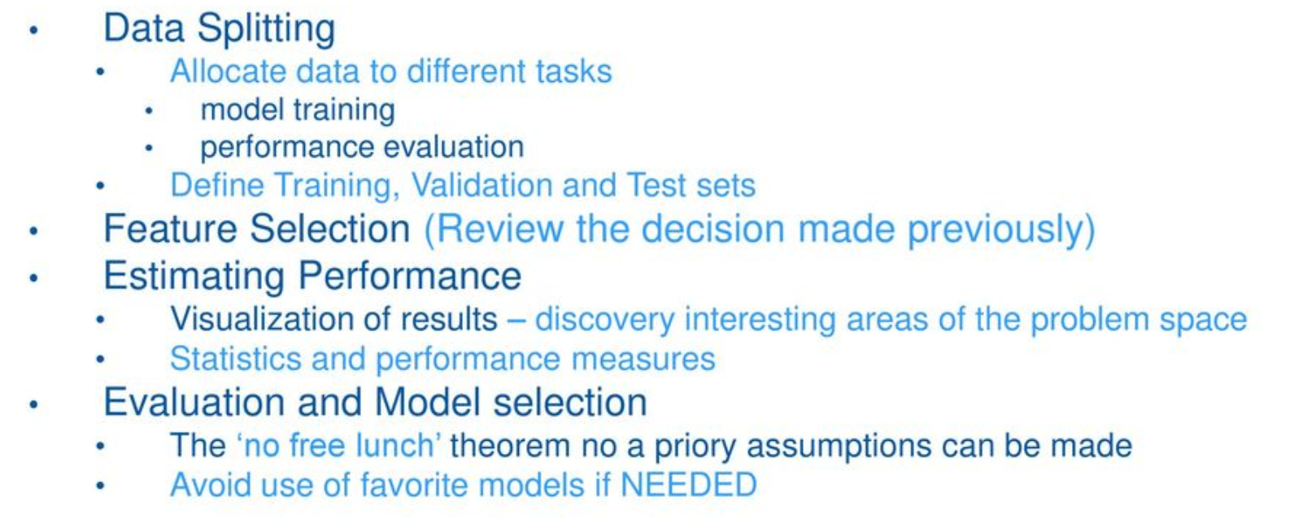
ML Overview – As a process

Slide 10
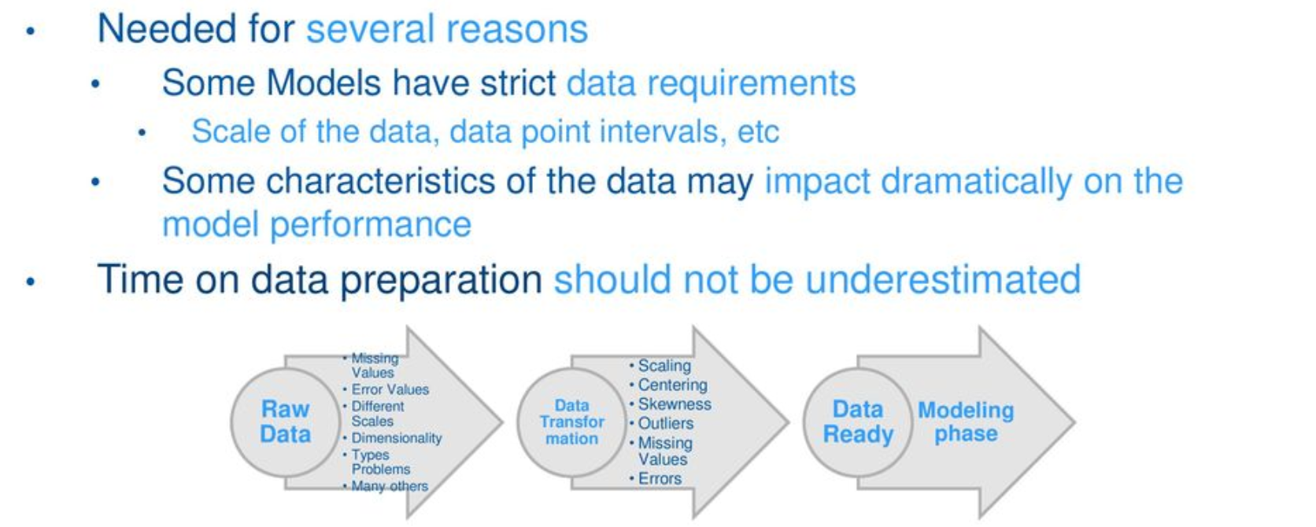
ML Data preparation - Process

Slide 11
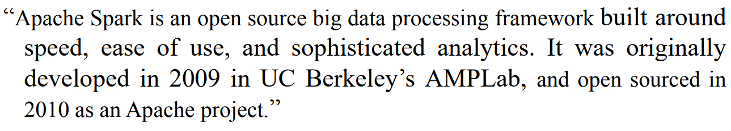
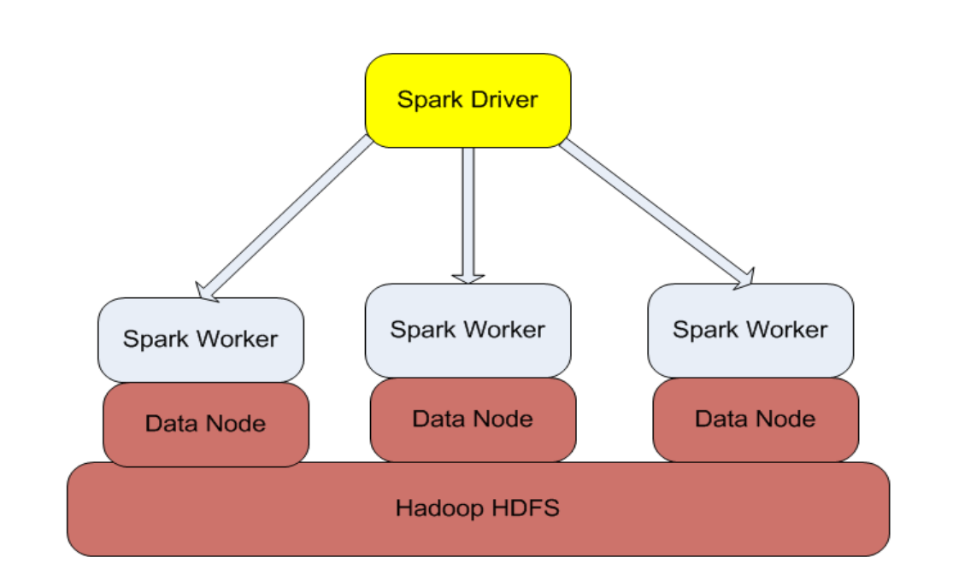
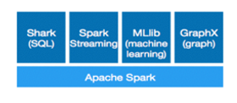
Spark Architecture

Slide 12
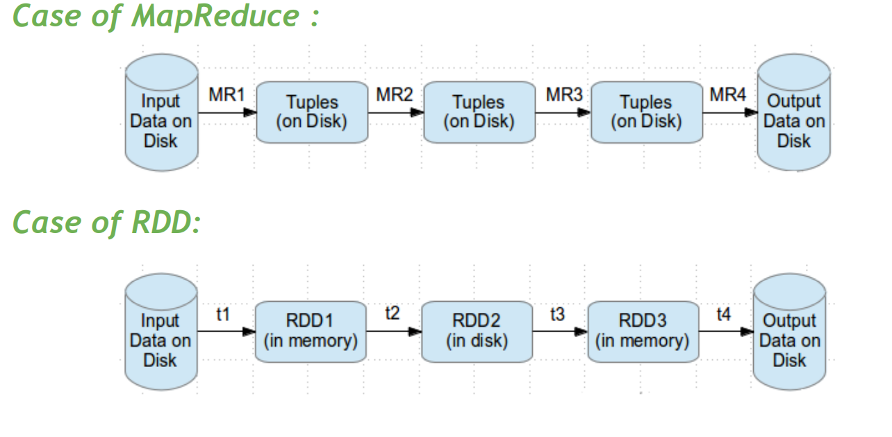
Map Reduce vs Spark as execution engine

Slide 13
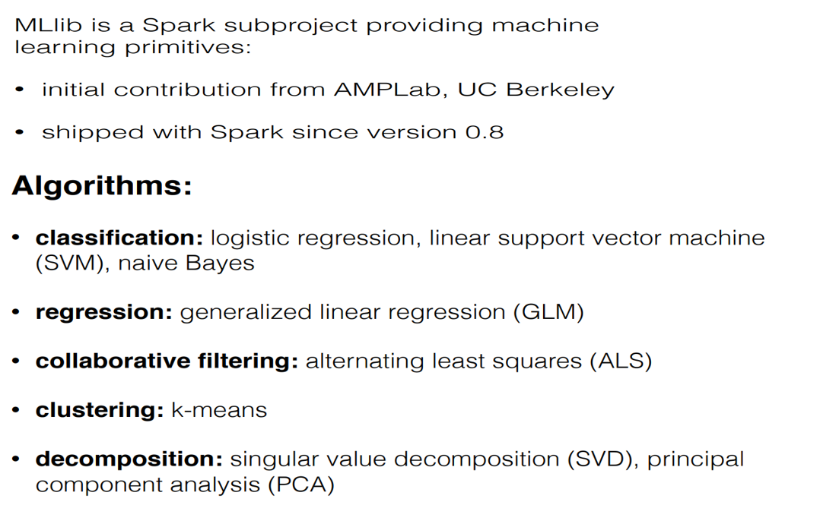
What is MLib?

Slide 14
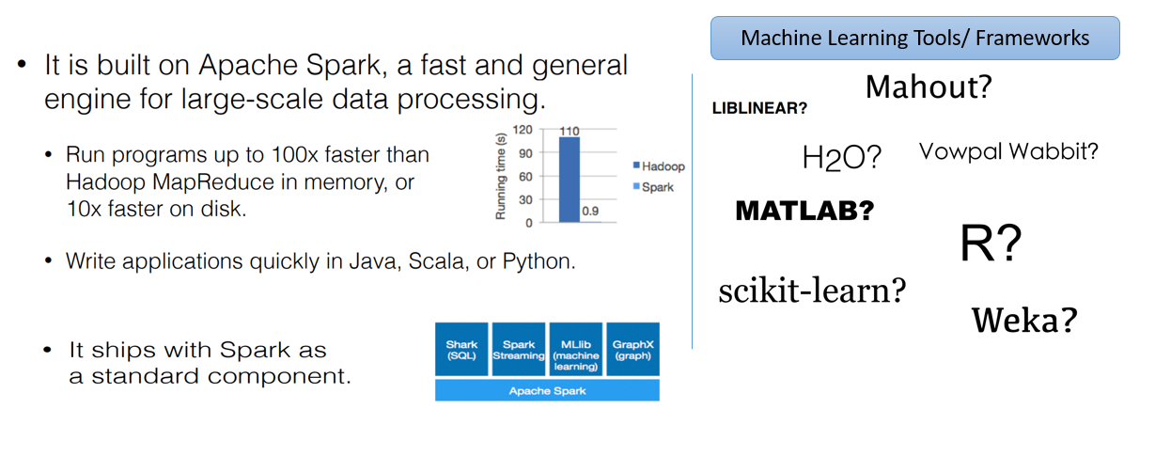
Why MLib?

Slide 15
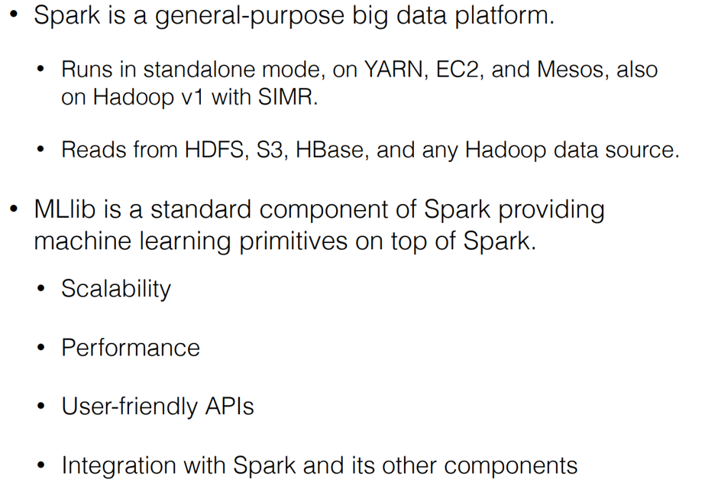
Why MLib?

Slide 16
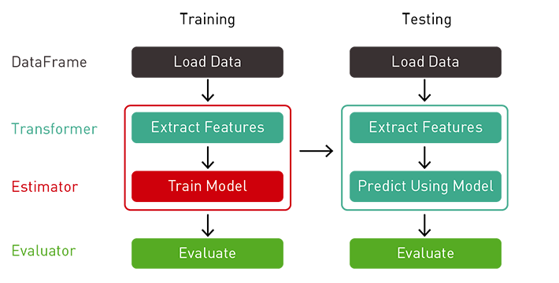
Spark ML
The Spark SQL and the Dataset/DataFrame APIs provide ease of use, space efficiency, and performance gains.
Spark ML provides a uniform set of high-level APIs, built on top of Data Frames with the goal of making machine learning scalable and easy. Having ML APIs built on top of Data Frames provides the scalability of partitioned data processing with the ease of SQL for data manipulation.
Spark Mlib components

Slide 17
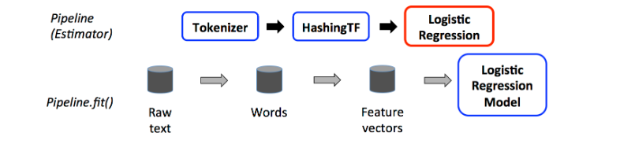
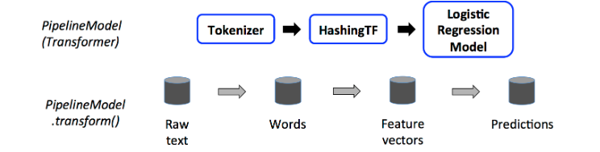
Spark Mlib – Key Components
Transformers
A Transformer implements a method transform(), which converts one DataFrame into another, generally by appending one or more columns
Estimators
An Estimator implements a method fit(), which accepts a DataFrame and produces a Model, which is a Transformer.
All models are initiated using estimators, the output of the models are “Transformers”

Slide 18
SPARK ML PIPELINE API
Spark ML Pipeline
Provides a high-level API that helps users create and tune practical ML pipelines. Allows one to combine multiple ML algorithms and utilities into a single pipeline.
A Pipeline is specified as a sequence of stages and each stage is a Transformer or an Estimator.
Spark ML API key components
DataFrame: Is the ML dataset and can hold a variety of data types.
Transformer: Is an algorithm that can transform one DataFrame into another DataFrame.
Estimator: Is an algorithm that can be fit on a DataFrame to produce a Transformer.
Pipeline: A Pipeline chains multiple Transformers and Estimators together to specify an ML workflow.
Parameter: This part of the API allows specifying parameters on all Transformers and Estimators.
https://docs.databricks.com/_static/notebooks/model-export-scala.html
Notes:
https://docs.databricks.com/_static/notebooks/model-export-scala.html

Slide 19
Example: Text Classification
Goal: Given a text document, predict its topic.
Dataset: “20 Newsgroups”
From UCI KDD Archive
Features
Label
Subject: Re: Lexan Polish?
Suggest McQuires #1 plastic polish. It will help somewhat but nothing will remove deep scratches without making it worse than it already is.
McQuires will do something...
1: about science
0: not about science
CTR, inches of rainfall, ...
text, image, vector, ...

Slide 20
Mlib Pipeline - Advantages
Training
Load data
Pain point
labels + plain text
Parameter tuning
Key part of ML
Involves training many models
For different splits of the data
For different sets of parameters
Extract features
labels + feature vectors
Train model
labels + predictions
Evaluate

Slide 21
Spark Mlib - Transformer
Training
Training
Load data
def transform(DataFrame): DataFrame
Extract features
Extract features
label: Double
text: String
label: Double
text: String
features: Vector
Train model
Train model
Evaluate
Evaluate

Slide 22
Spark Mlib - Estimator
Training
def fit(DataFrame): Model
Extract features
LogisticRegression
Model
label: Double
text: String
features: Vector
Train model
Evaluate

Slide 23
Spark Mlib – Model development
Training
Pipeline is a type of Estimator
def fit(DataFrame): Model
Load data
Extract features
label: Double
text: String
PipelineModel
Train model
Evaluate
Testing/Production
PipelineModel is a type of Transformer
def transform(DataFrame): DataFrame
Load data
Extract features
text: String
text: String
features: Vector
prediction: Double
Predict using model
Act on predictions

Slide 24
Summary
Training
Current data schema
DataFrame
Load data
label: Double
text: String
Transformer
Tokenizer
words: Seq[String]
Transformer
HashingTF
features: Vector
Estimator
LogisticRegression
prediction: Double
Evaluator
BinaryClassification
Evaluator
Evaluate the model using AUC, RMSE Other methods..

Slide 25
Mlib pipeline- Data Frame
DataFrame: RDD + schema + DSL
Named columns with types
label: Double
text: String
words: Seq[String]
features: Vector
prediction: Double
label | text | words | features
0 | This is ... | [“This”, “is”, …] | [0.5, 1.2, …]
0 | When we ... | [“When”, ...] | [1.9, -0.8, …]
1 | Knuth was ... | [“Knuth”, …] | [0.0, 8.7, …]
0 | Or you ... | [“Or”, “you”, …] | [0.1, -0.6, …]

Slide 26
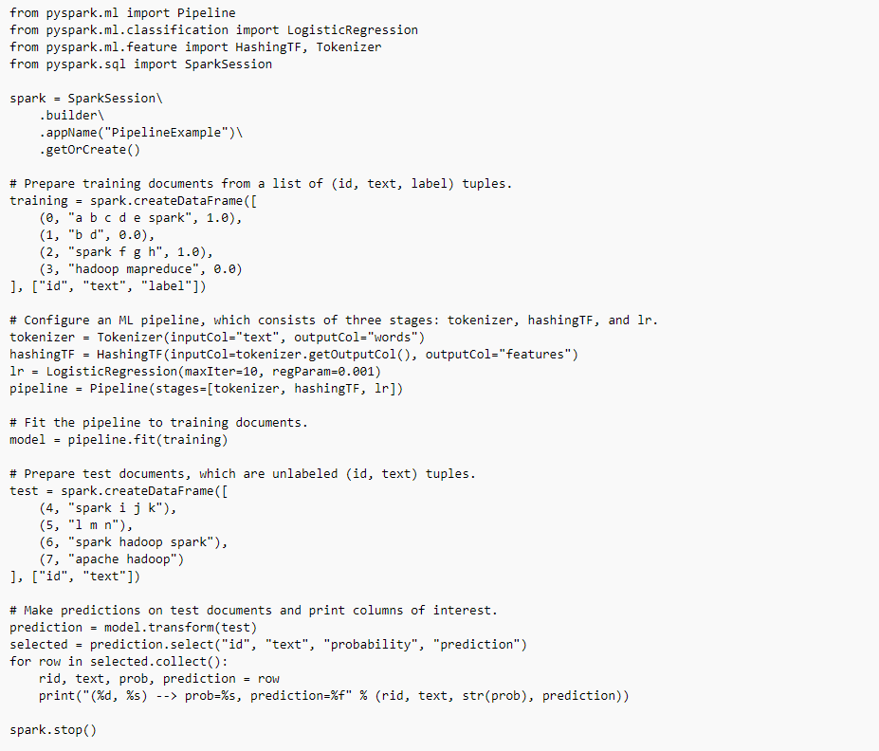
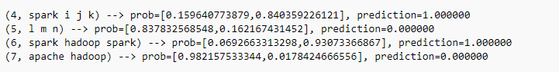
Logistic Regression with Spark
Output

Slide 27
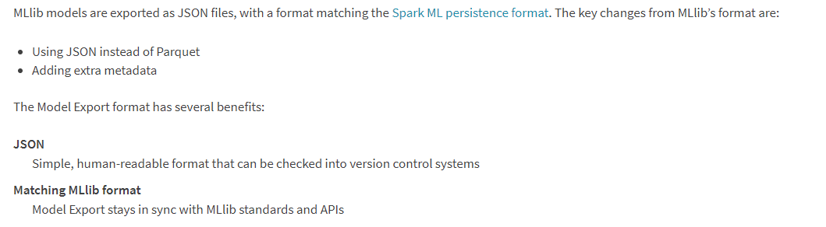
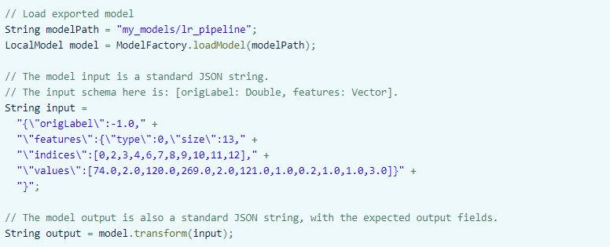
Spark Mlib Export | Import

Slide 28
THANK YOU

